Slide 1





MKT-346
INFLUENCER MARKETING CAMPAIGN
Boutique marketing agency dedicated to helping local business owners grow their visibility and customer base through strategic social media marketing.
With a personalized approach, MM Marketing empowers small businesses to connect with their communities and build stronger brands online.
Presented By: Tomoki, Carter & Mike
Notes:
TOM

Slide 2

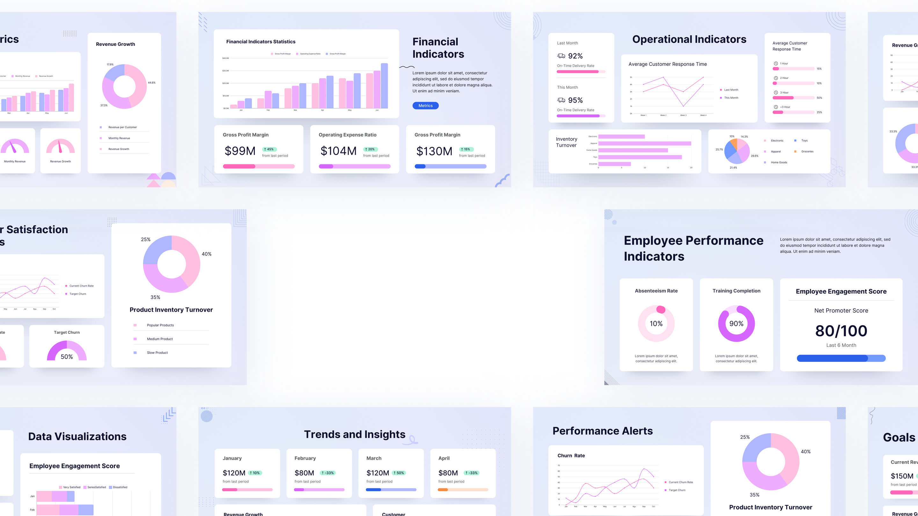



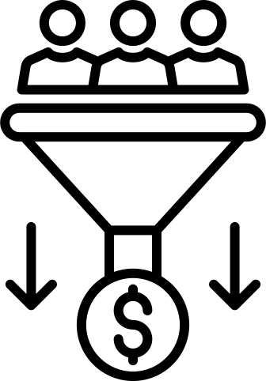
CAMPAIGN GOAL
ENGAGEMENT & CONVERSION
Notes:
TOM

Slide 3

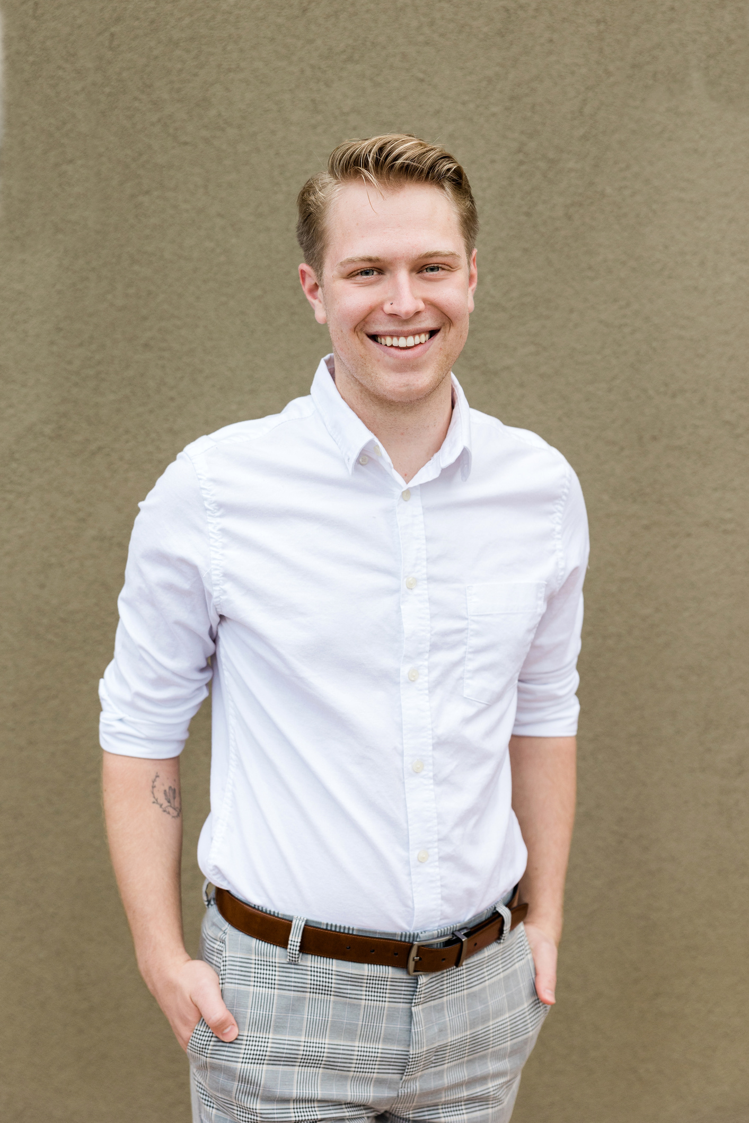
AUDIENCE PERSONA
Small Business Owner, 25-55 years old male/female living in a small country town in the United States.
Values customer relationships and is overwhelmed managing both the business and social media.
Uses primarily Instagram and Facebook and engages with viral musical trends and local groups.
Notes:
TOM

Slide 4



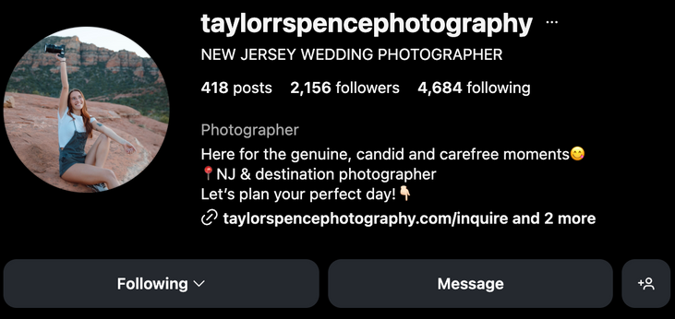
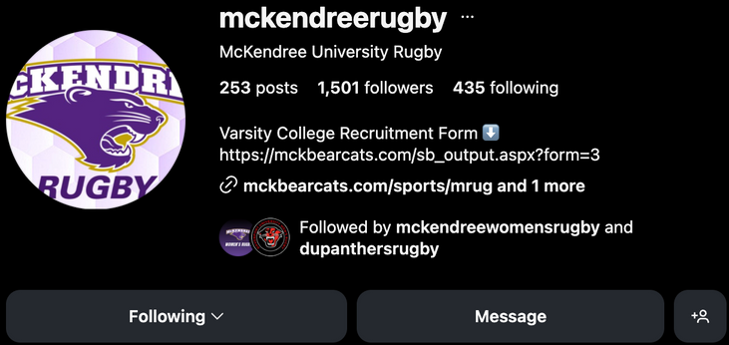
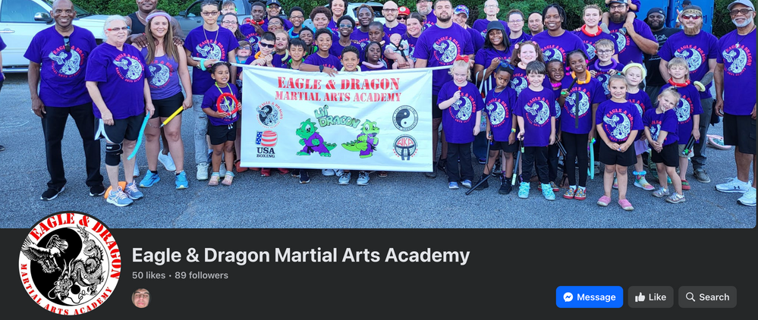


Influencer Selection
Taylor Spence Photography
McKendree Rugby
Eagle & Dragon Martial Arts Academy
Followers: 2155
Followers: 1501
Followers: 89
Industry: Photography
Industry: Sport Club
Industry: Sport Gym
Target Audience:
Other Photographers
Target Audience:
Other Sport Teams
Target Audience:
Other Gym Owners
Notes:
MIKE

Slide 5


Content Strategy
Message Theme & Engagement Tactics
Posting Time & Frequency
They are too focused on their business and don’t have time for marketing
→ That’s why they need MM Marketing
Posting should be scheduled every Sunday from 6PM to 10PM for a month
FREE Marketing Analysis of their business if they fill out the form on the website
Notes:
MIKE

Slide 6


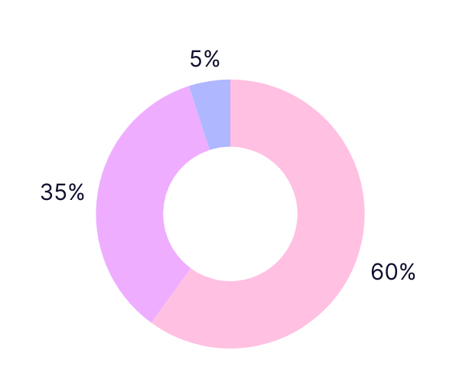
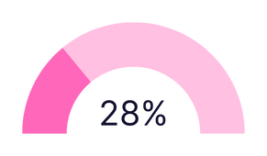
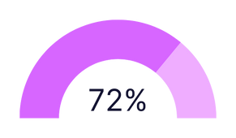

Metrics & KPIs
Measure performance of different posts week by week.
Compare likes, follows, shares, etc for different posts to see what posts perform the best.
Measure which influencers perform the best.
Which influencers are showing steady growth and worth continuing to work with?
Graph out successful vs unsuccessful posts.
Influencer Performance
Taylor Spence Photography
Unsuccessful
Successful
McKendree Rugby
Eagle & Dragon Martial Arts Academy
Notes:
CARTER

Slide 7






Sample Content Mockup
Influencer explaining how busy he is running his business and taking care of his clients.
He knows that marketing is the key when it’s about bringing more customers to the door.
So, he let a boutique marketing agency like MM Marketing help him take care of all the marketing for him.
Results talk for themselves
⟶ Showing his results working with MM Marketing himself
Notes:
CARTER

Slide 8


Thank You!

